Slide 1
City of Columbiana Community Reinvestment Area Program:
Assessment and Evaluation
Thomas Maraffa
Independent Consultant for Columbiana County Economic Development Agency

Slide 2
Objectives
Compare the Columbiana CRA Program to that of Comparable Cities
Evaluate the Impact of the CRA Program on the City of Columbiana and the Columbiana Exempted Village School District

Slide 3
Information Sources
Interviews with public officials and selected members of the community.
Interviews with officials of peer communities and Ohio Department of Development.
Public CRA data from Ohio Department of Development.
CRA data for City of Columbiana
CRA data for peer communities
Census data for Columbiana and vicinity
Census data for peer communities
Columbiana Exempted Village School District financial and enrollment data
Property tax and income tax data from state and local public sources

Slide 4
Community Reinvestment Areas
What is a Community Investment Area(CRA)?
Tax Abatements for Economic Development
Authorized by State of Ohio
Commercial and Residential Development
No Abatement on Land
Communities can choose to designate specific areas of the city as CRA eligible or designate the entire city as a CRA.
Does the city want to target investment in specific areas determined to need redevelopment or desirable for future development or does the city want to use the CRA to promote economic growth for the entire city?
Local Flexibility in Term and Amount
Post 1994 communities can vary the length of the CRA and the rate of CRA abatement. This may be codified in municipal ordinance or through negotiation.

Slide 5
Community Reinvestment Areas in Columbiana
Authorized by 2018 Ordinance
Designates Entire Village as CRA
 | Commercial/Industrial | Residential
New Construction | Up 15 years and up to and 100% negotiated on case by case basis. | 15 years and 100% .
Improvement of Existing Buildings | Up to 12 years and 100% negotiated on case by case basis. | Ten (10) years and 100% for every residential dwelling unit containing not more than two housing units and in which the cost of remodeling is at least $2,500. 12 years and 100% for dwellings containing not more than two housing units and in which the cost of remodeling is at least $5,000 .

Slide 6
How Does the Columbiana CRA Program Compare to Peer Cities?
City | County | Metro Area | Population
Delphos | Allen | Lima | 7101
Wapakoneta | Auglaize | Lima | 9867
New Carlisle | Clark | Springfield | 5785
Chardon | Geauga | Cleveland | 5149
Napolean | Henry | Toledo | 8749
Waterville | Lucas | Toledo | 5523
Brookville | Montgomery | Dayton | 5868
Moraine | Montgomery | Dayton | 6307
Shelby | Richland | Mansfield | 9317
Northwood | Wood | Toledo | 5265

Slide 7
Columbiana and Peer City CRA Programs
CRA Districts
Commercial/Industrial
Residential
School Compensation Agreements
Dedicated School Income Tax

Slide 8
CRA Districts
Does the city want to target investment in specific areas determined to need redevelopment or desirable for future development or does the city want to use the CRA to promote economic growth for the entire city?
 | Entire City | CRA Districts
Brookville |  | X
Chardon |  | X
Columbiana | X
Delphos | X
Moraine
Napolean |  | X
New Carlilse |  | X
Northwood |  | X
Shelby
Wapakoneta | X
Waterville |  | X

Slide 9
CRA and Commercial/Industrial Development
 | Number of Commercial/Industrial CRA Projects
Brookville | 2
Chardon | 3
Columbiana | 14
Delphos | 1
Moraine | 10
Napolean | 8
New Carlilse
Northwood | 8
Shelby | 4
Wapakoneta | 3
Waterville

Slide 10
Comparison of Commercial/Industrial CRA Abatements—Columbiana and Peer Cities
% Abatement | Years | Columbiana | Peer Cities
100% | 15 | 5 | 5
100% | 10-14 |  | 25
100% | Less than 10 |  | 4
75% | 15
75% | 10 | 3
75%//00% | 10/5 | 1
50% | 15 |  | 3
50% | 10-14 | 2 | 1
50% | Less than 10
 |  | 14 | 38

Slide 11
Columbiana CRA Supported Residential Development
100% Abatement for 15 Years
170+ Housing Starts
Construction Cost Value of $35.1 Million
3 Remodeling CRA—Value of $111 thousand

Slide 12
Peer City CRA Supported Residential Development
Shelby-16 single family homes; 5 remodeled homes
Delphos-3 new single family homes; 10 remodeled homes
Chardon-1 apartment complex
Napoleon-1 apartment complex; 1 development with residential villas

Slide 13
School Compensation Agreements
Since CRA abate property taxes, which are a primary source of public school revenues, communities may incorporate school revenue compensation agreements into the CRA.
This serves two purposes:
1) it provides revenue to the school district.
2) It promotes goodwill between the district and the municipality and encourages a spirit of cooperation. Examples of approaches are:
A school donation agreement equal to the reduction in revenue
If payroll exceeds $1million, ½ of income tax to school district.
Columbiana does not have school compensation agreement.

Slide 14
Dedicated School Income Tax
The existence of a school district income tax complements CRA because employment generated by commercial/industrial CRA projects benefits the school district through increases in income tax revenue.
The school district also benefits from income tax revenue generated by new residents of housing residential CRA construction.
School Income Tax
Wapakoneta .75%
Shelby 1%
Northwood .25%
Columbiana 1%

Slide 15
Columbiana and Peer City Population and Income Change

Slide 16
% Population Change, 2000-2020

Slide 17
% Population Change, 2000-2010

Slide 18
% Population Change, 2010-2020

Slide 20
How Has Columbiana Changed Since the CRA
Commercial/Industrial Development
Direction of Residential Development
Family and Household Income
Housing Value
City and School Finances

Slide 21
CRA Commercial/Industrial Abatements in Columbiana
14 Projects
$52.5 Million Investment
348 New Jobs Created
442 Jobs Retained

Slide 22
Commericial/Industrial Development
Comparison of CRA and Non CRA Commercial/Industrial Development
 | CRA Supported Projects |  |  | Non CRA Supported Projects |  |  | Total
Year | Number | Construction Cost($Millions) |  | Number | Construction Cost($Millions) |  | Number | Construction Cost($Millions)
2019 | 2 | $1.41 |  | 6 | $1.44 |  | 8 | $2.85
2020 | 2 | $1.63 |  | 5 | $1.48 |  | 7 | $3.11
2021 | 7 | $5.38 |  | 6 | $0.90 |  | 13 | $6.28
Projected | 2 | $30.00 |  | 1 | $32.00 |  | 3 | $62.00
Total | 13 | $38.42 |  | 18 | $35.82 |  | 31 | $74.24

Slide 23
Columbiana CRA Supported Residential Development
172 Housing Starts
Focused on Planned Residential Communities
Construction Cost Value of $35.1 Million
3 Remodeling CRA Abatements—Value of $111 thousand

Slide 24
Columbiana CRA Supported Residential Development
Mahoning County
68 Units
42 Single Family
9 Duplexes
17 Triplexes
$9.87 Million Construction Cost
Columbiana County
80 Single Family
$25.35 Million Construction Cost

Slide 25
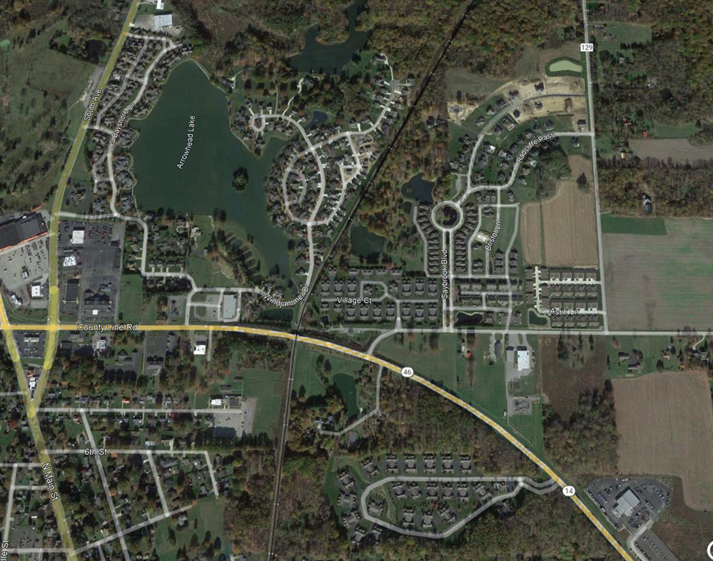
Columbiana CRA Supported Residential Development

Slide 26
CRA Supported Residential Developments

Slide 27
2006

Slide 28
2014

Slide 29
2020

Slide 30
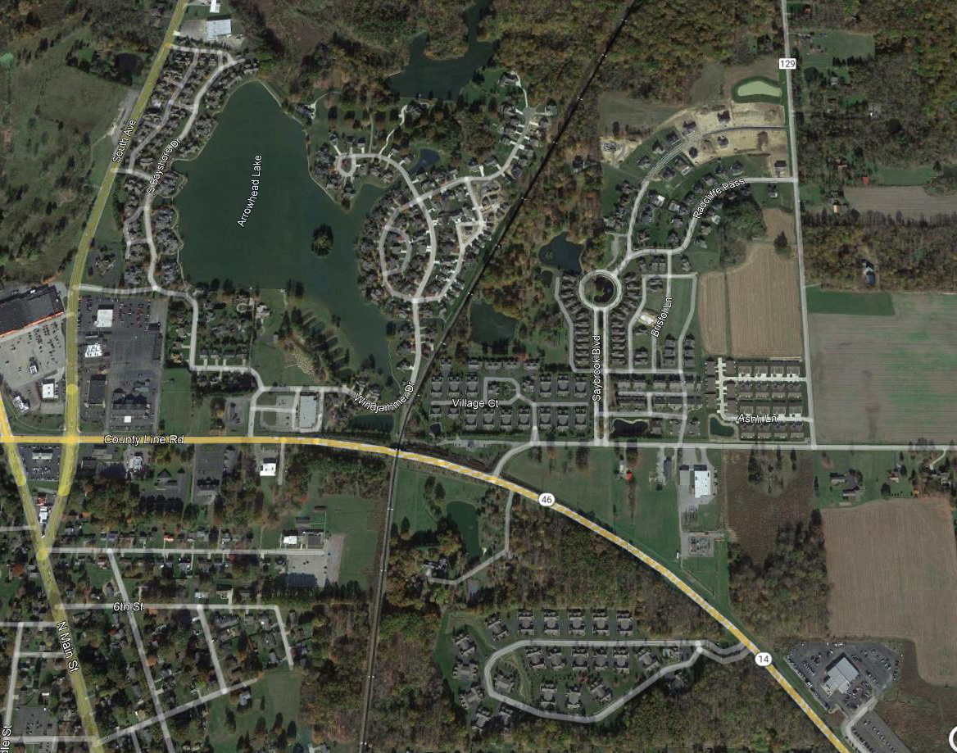
2014
2021

Slide 31
Columbiana Family Income and Housing Value, 2015-2020
 | 2015 |  | 2020
Families | 1,790 |  | 1,674
Less than $10,000 | 82 | 4.6% | 35 | 2.10%
$10,000 to $14,999 | 41 | 2.3% | 38 | 2.30%
$15,000 to $24,999 | 149 | 8.3% | 114 | 6.80%
$25,000 to $34,999 | 242 | 13.5% | 63 | 3.80%
$35,000 to $49,999 | 189 | 10.6% | 206 | 12.30%
$50,000 to $74,999 | 480 | 26.8% | 280 | 16.70%
$75,000 to $99,999 | 210 | 11.7% | 350 | 20.90%
$100,000 to $149,999 | 290 | 16.2% | 173 | 10.30%
$150,000 to $199,999 | 84 | 4.7% | 374 | 22.30%
$200,000 or more | 23 | 1.3% | 41 | 2.40%
Median family income (dollars) | $61,601 |  | $81,131
Mean family income (dollars) | $69,825 |  | $95,055
VALUE | 2015 |  | 2020
Owner-occupied units | 1,950 | 1,950 | 2,077 | 2,077
Less than $50,000 | 247 | 12.7% | 182 | 8.80%
$50,000 to $99,999 | 385 | 19.7% | 364 | 17.50%
$100,000 to $149,999 | 523 | 26.8% | 418 | 20.10%
$150,000 to $199,999 | 435 | 22.3% | 384 | 18.50%
$200,000 to $299,999 | 257 | 13.2% | 584 | 28.10%
$300,000 to $499,999 | 103 | 5.3% | 145 | 7.00%
$500,000 to $999,999 | 0 | 0.0% | 0 | 0.00%
$1,000,000 or more | 0 | 0.0% | 0 | 0.00%
Median (dollars) | $132,200 |  | $156,300

Slide 32
Median Family Income | 2015 | 2020 | Change | % Change
Columbiana City | $61,601 | $81,131 | $19,530 | 31.7%
Columbiana County | $55,820 | $65,673 | $9,853 | 17.7%
East Liverpool | $39,828 | $41,323 | $1,495 | 3.8%
Salem | $50,518 | $58,524 | $8,006 | 15.8%
Median Home Value | 2015 | 2020 | Change | % Change
Columbiana City | $132,200 | $156,300 | $24,100 | 18.2%
Columbiana County | $101,100 | $105,500 | $4,400 | 4.4%
East Liverpool | $56,300 | $61,900 | $5,600 | 9.9%
Salem | $91,100 | $92,000 | $900 | 1.0%
Housing | Total Housing Units | Number Built 2014- | % Built 2014-
Columbiana City | 3301 | 64 | 1.9%
Columbiana County | 46800 | 325 | 0.7%
East Liverpool | 5260 | 41 | 0.8%
Salem | 5803 | 5 | 0.1%
Population | 2000 | 2010 | 2020 | % Change 2000-2010 | % Change 2010-2020
Columbiana City | 5675 | 6384 | 6559 | 12.5% | 2.7%
Columbiana County | 112075 | 107841 | 101877 | -3.8% | -5.5%
East Liverpool | 13089 | 11195 | 9958 | -14.5% | -11.0%
Salem | 12197 | 12303 | 11915 | 0.9% | -3.2%

Slide 33
Comparison of Housing Starts—Columbiana v Mahoning/Columbiana Counties
Housing Starts | 2018 | 2019 | 2020 | 2021 | Total
Columbiana Village | 34 | 65 | 76 | 45 | 220
Mahoning County | 109 | 90 | 99 | 57 | 355
Columbiana County |  |  |  |  | 0
Springfield Twp | 18 | 19 | 15 | 12 | 64
Beaver Twp | 28 | 14 | 22 | 12 | 76
Green Twp | 3 | 2 | 5 | 3 | 13
Goshen Twp | 2 | 3 | 2 | 4 | 11
Smith Twp | 1 | 2 | 6 | 3 | 12
Total Southern Tier Mahoning | 52 | 40 | 50 | 34 | 176

Slide 34
Mahoning and Columbiana County Census Tracts

Slide 35
Columbiana Census Tract Trends
Median Family Income | 2015 | 2020 | Change | % Change
Tract 9502 | $61,360 | $70,885 | $9,525 | 15.5%
Tract 8135 | $62,187
Tract 8135.01 | $62,185 | $75,647 | $13,462 | 21.6%
Tract 8135.02 | $62,185 | $74,391 | $12,206 | 19.6%
Median Home Value | 2015 | 2020 | Change | % Change
Tract 9502 | $137,400 | $139,200 | $1,800 | 1.3%
Tract 8135 | $172,600
Tract 8135.01 | $172,600 | $145,800 | -$26,800 | -15.5%
Tract 8135.02 | $172,600 | $212,100 | $39,500 | 22.9%

Slide 36
City Income Tax Collection
 | 2015 | 2020 | $ Change | % Change
Income Tax Revenue | $2,231,000 | $2,512,000 | $281,000 | 12.6%
Population 18 and Older | 5315 | 5357 | 42 | 0.8%
Revenue PP | $420 | $469 | $49 | 11.7%

Slide 37
The CRA and the Columbiana Exempted Village Schools
Economic and Enrollment Trends
How has the CRA Changed School Finances

Slide 38
The CRA and the Columbiana Exempted Village Schools
Enrollment
Revenue
Property Tax
Income Tax
Expenses

Slide 39
Factors Affecting School District Enrollment
Students Moving Into or Out of the District
Students Entering or Leaving the District through Open Enrollment
Students Enrolling at Private/Parochial Schools

Slide 40
Columbiana Exempted Village School Enrollment
33 Students in CRA Abatement Homes
10 New Students in CRA Abatement Homes

Slide 41
CEVSD Total Property Tax Revenue, 2015-2021

Slide 42
CEVSD Mahoning County Property Tax Revenue, 2015-2021

Slide 43
CEVSD Columbiana County Property Tax Revenue, 2015-2021

Slide 44
CEVSD Total Income Tax Revenue, 2015-2021

Slide 45
CEVSD Total Local Revenue Per Pupil, 2015-2021

Slide 46
CEVSD Property Tax Revenue Per Pupil, 2015-2021

Slide 47
CEVSD Income Tax Revenue Per Pupil, 2015-2021

Slide 48
CEVSD FTE Teachers 2016-2021

Slide 49
Assumptions
$117,000 Median Family Income CRA Homes
1% Income Tax
$400 Annual Property Tax for Land
$1500 Annual Property Tax for Non CRA Abatement Property
175 Developed Units

Slide 50
Scenario One
Current CRA Abatement and Current Development
Property Tax
175 Units x $400 per unit $70,000
Income Tax
175 Families X $1170 per Family $205,625
Total Revenue $275,625

Slide 51
Scenario Two
No CRA Abatement and No Development
Property Tax
175 Units x $400 per unit $70,000
Income Tax
No Revenue Generated $0
Total Revenue $70,000

Slide 52
Scenario Three
No CRA Abatement and Development of 40 Units
Property Tax
40 units x $1500 + 135 units x $400 $114,000
Income Tax
40 families x $1170 $46,800
Total Revenue $160,800

Slide 53
Scenario Four
No CRA Abatement and Development of 120 Units
Property Tax
55 units x $400 + 120 units x $1500 $202,000
Income Tax
120 families x $1170 per family $140,400
Total Revenue $342,400

Slide 54
Scenario Five
No CRA Abatement and Current Level of Development
Property Tax
175 units x $1500 $262,500
Income Tax
175 families x $1170 per family $204,000
Total Revenue $466,500

Slide 55
Annual Columbiana EVS Tax Revenue Alternative Development Scenarios
 |  | Property Tax | Income Tax | Total
1. | No CRA Abatement and No Development | 175 undeveloped units x $400 per unit = $70,000 | $0 | $70,000
2. | Current CRA Abatement and Current Development | 175 developed units x $400 = $70,000 | 175 families x 1170 per family = $205,625 | $275,625
3. | No CRA Abatement and Development of 40 Units | 40 units x $1500 + 135 units x $400 = 114,000 | 40 families x $1170 = $46,800 | $160,800
4. | No CRA Abatement and Development of 120 Units | 55 units x 400 + 120 units x $1500 = $202,000 | 120 families x $1170 per family = $140,400 | $342,400
5. | No CRA Abatement and Current Level of Development | 175 units x $1500 = $262,500 | 175 families x $1170 per family = $204,000 | $466,500

Slide 56
Conclusions
Columbiana Has a More Aggressive CRA Program Than Comparable Cities
The Use of the CRA Program for Residential Development is Distinctive
Columbiana has Experienced Significant Growth Since the CRA Program Began
Economic Development and Growth within Columbiana County has shifted to the Columbiana Area
It is Unlikely that Observed Development Would have Occurred without the CRA Program
The Impact of the CRA Program on School District Enrollment has been Minimal
The CRA Program Has Not Has a Negative Effect on School District Finances.

Slide 57
What About the Future?
Changes in Income Tax and Property Tax Rate
Economic Conditions That Impact Real Estate Market
Perception of School District
Land for Development

Slide 58
Recommendations
Develop a database of CRA properties and a dashboard to assess financial impact.
Community stakeholders should agree on metrics and share data for the database.
Consider the feasibility of a school district compensation program.
Require households and businesses to provide information for the dashboard.

